Slide 1
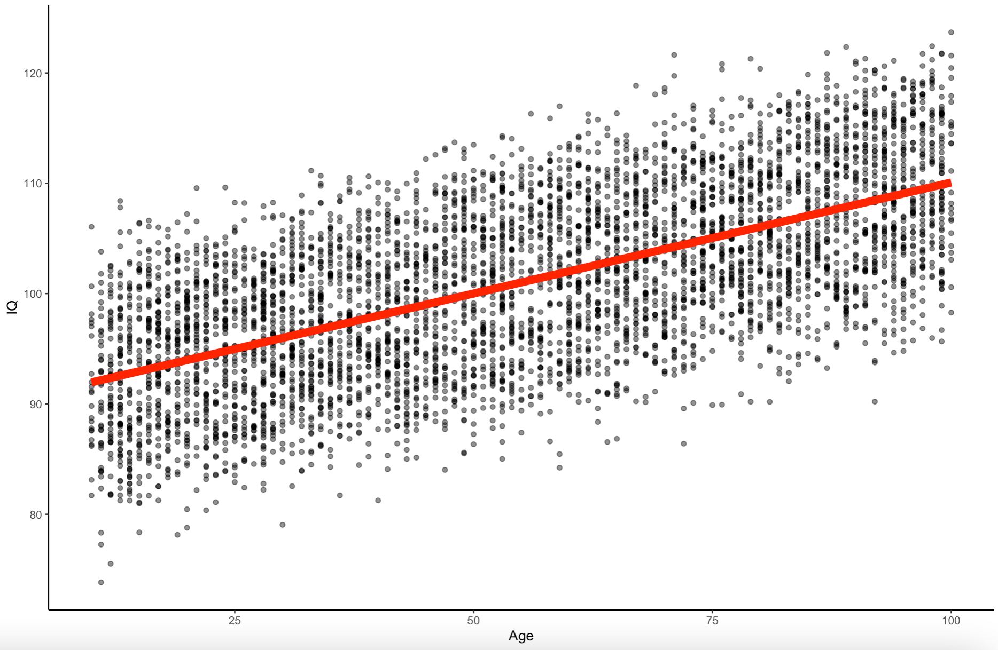
Multiple Regression, Moderation, and Mediation Chad C. Williams www.chadcwilliams.com

Slide 2
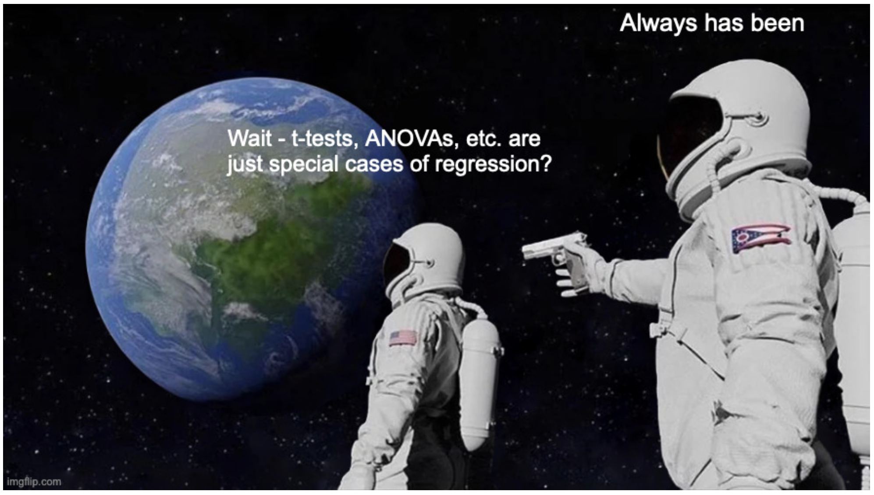

Slide 3
www.github.com/chadcwilliams > Repositories > R Workshops

Slide 4
Outline
Multiple Regression Conceptual
Multiple Regression Applied
Moderation Conceptual
Mediation Conceptual
Moderation Applied
Mediation Applied

Slide 5
Outline
Multiple Regression Conceptual
Multiple Regression Applied
Moderation Conceptual
Mediation Conceptual
Moderation Applied
Mediation Applied

Slide 6
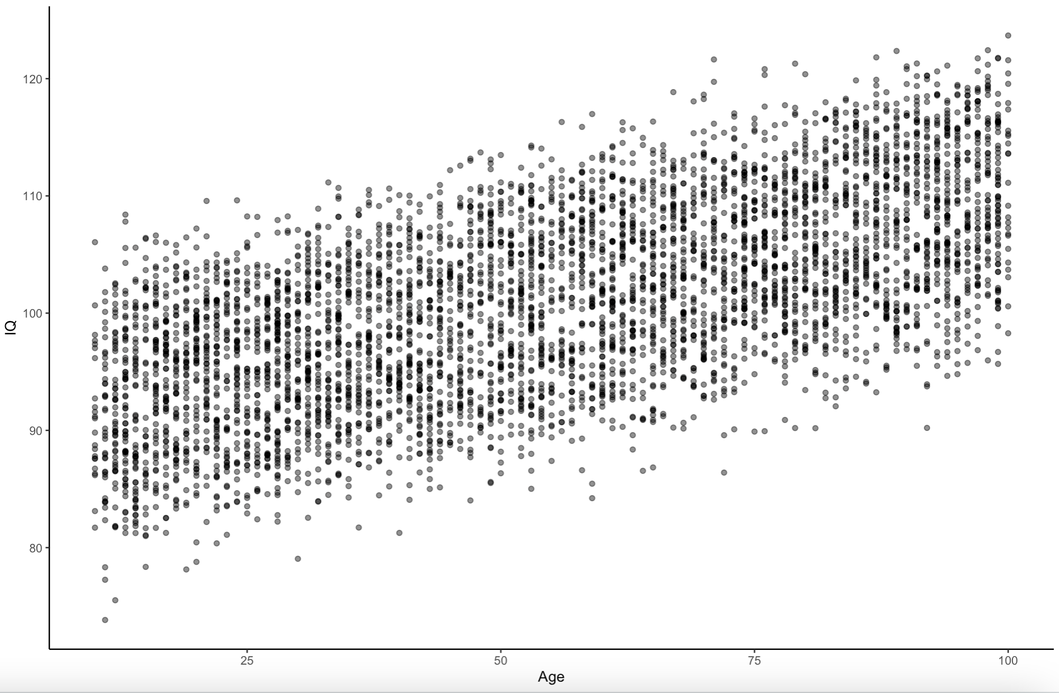
The Data
Made up
N = 5000
Age, IQ, Education

Slide 7
What is this?
Simple Regression
Equation:
Y ~ β₀ + β₁X + ε

Slide 8
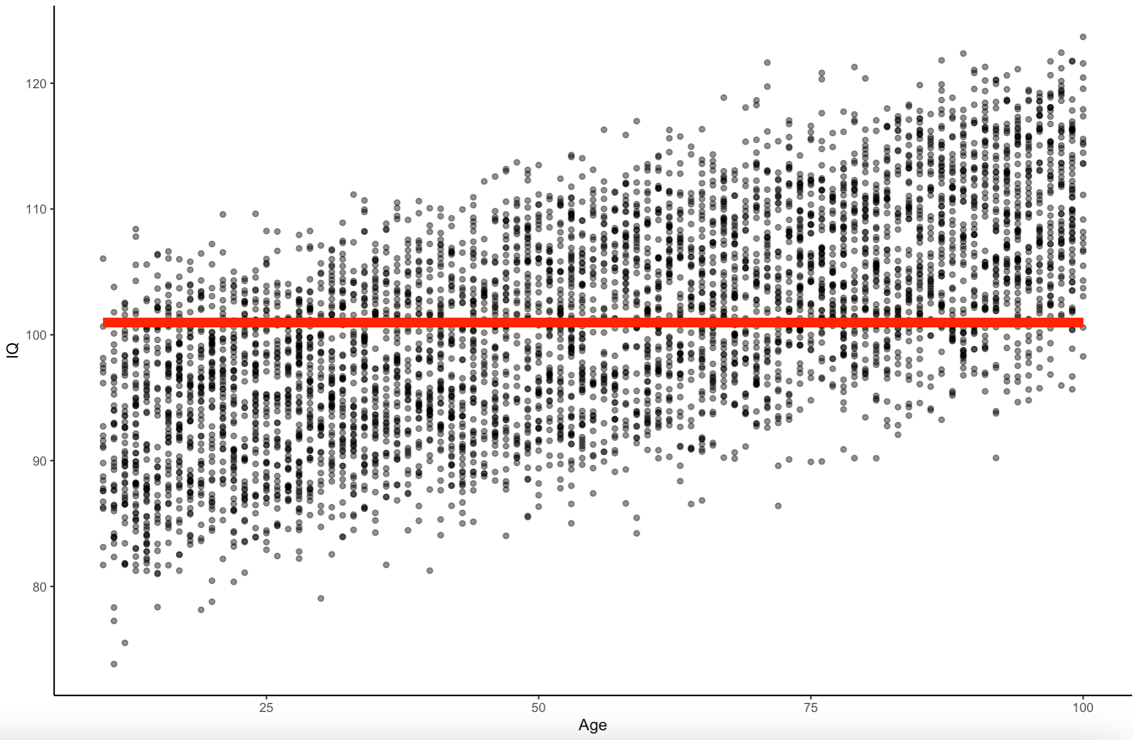
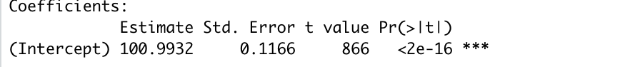
What is this?
The mean
Equation:
Y ~ β₀ + ε
IQ ~ Mean + ε

Slide 9
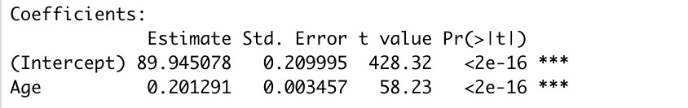
What is this?
Simple Regression
Equation:
Y ~ β₀ + β₁X + ε
IQ ~ β₀ + β₁Age + ε

Slide 10
Equations
DV
Slope
Error
Y ~ β₀ + β₁X₁ + ε
Y-Int
IV

Slide 11
Equations
Coefficient
Outcome
Residual
Y ~ β₀ + β₁X₁ + ε
Predictor
Coefficient

Slide 12
Equations
DV
Slope
Error
Y ~ β₀ + β₁X₁ + ε
Y-Int
IV
IQ ~ β₀ + β₁Age + ε

Slide 13
What is this?
Correlation/Regression
Equation:
Y ~ β₀ + β₁X + ε
IQ ~ β₀ + β₁Age + ε

Slide 14
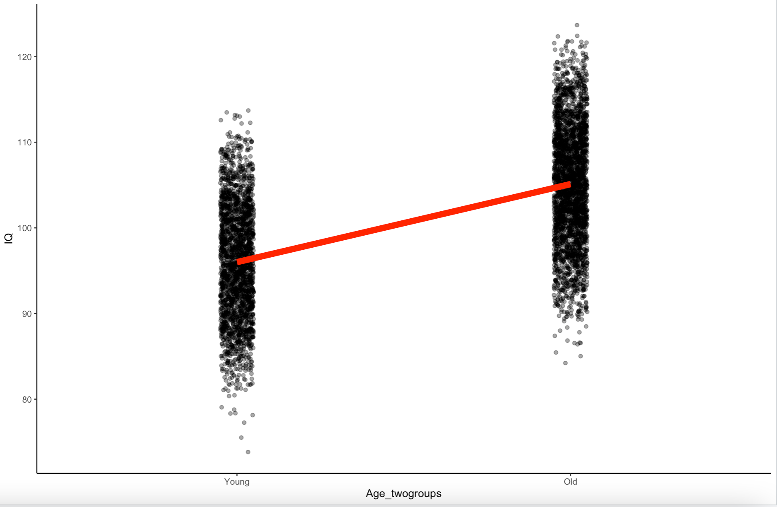
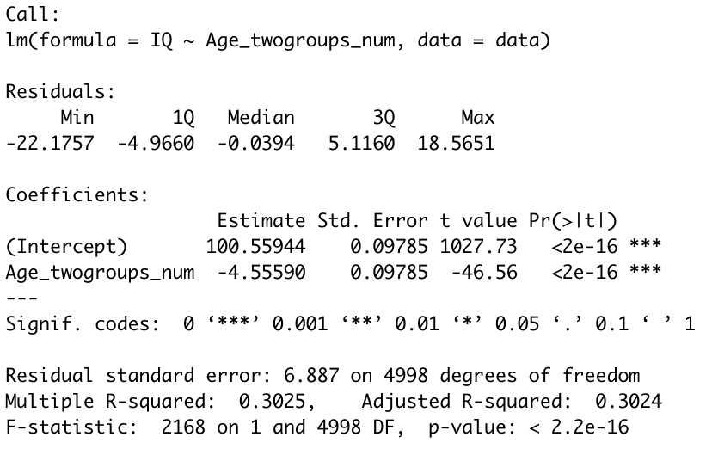
What is this?
T-Test
Equation:
Y ~ β₀ + β₁X + ε
IQ ~ β₀ + β₁Age + ε

Slide 15
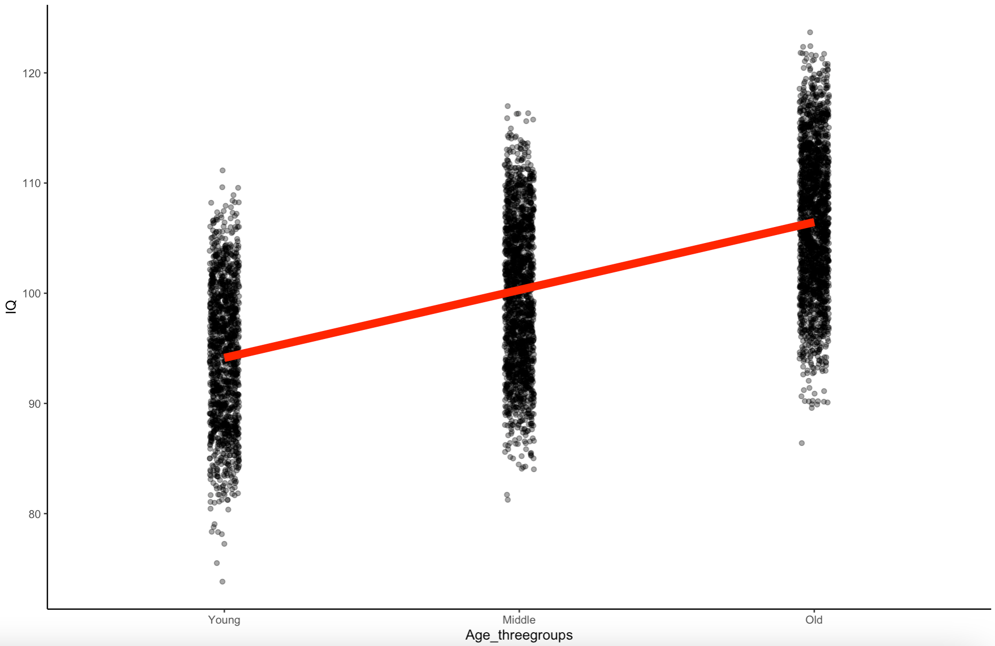
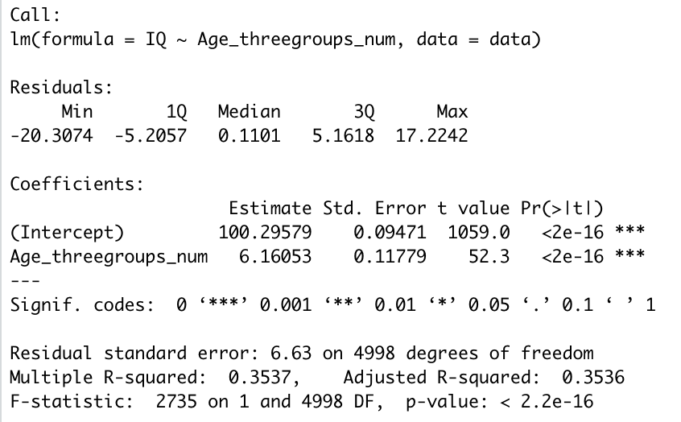
What is this?
One-Way ANOVA
Equation:
Y ~ β₀ + β₁X + ε
IQ ~ β₀ + β₁Age + ε

Slide 16
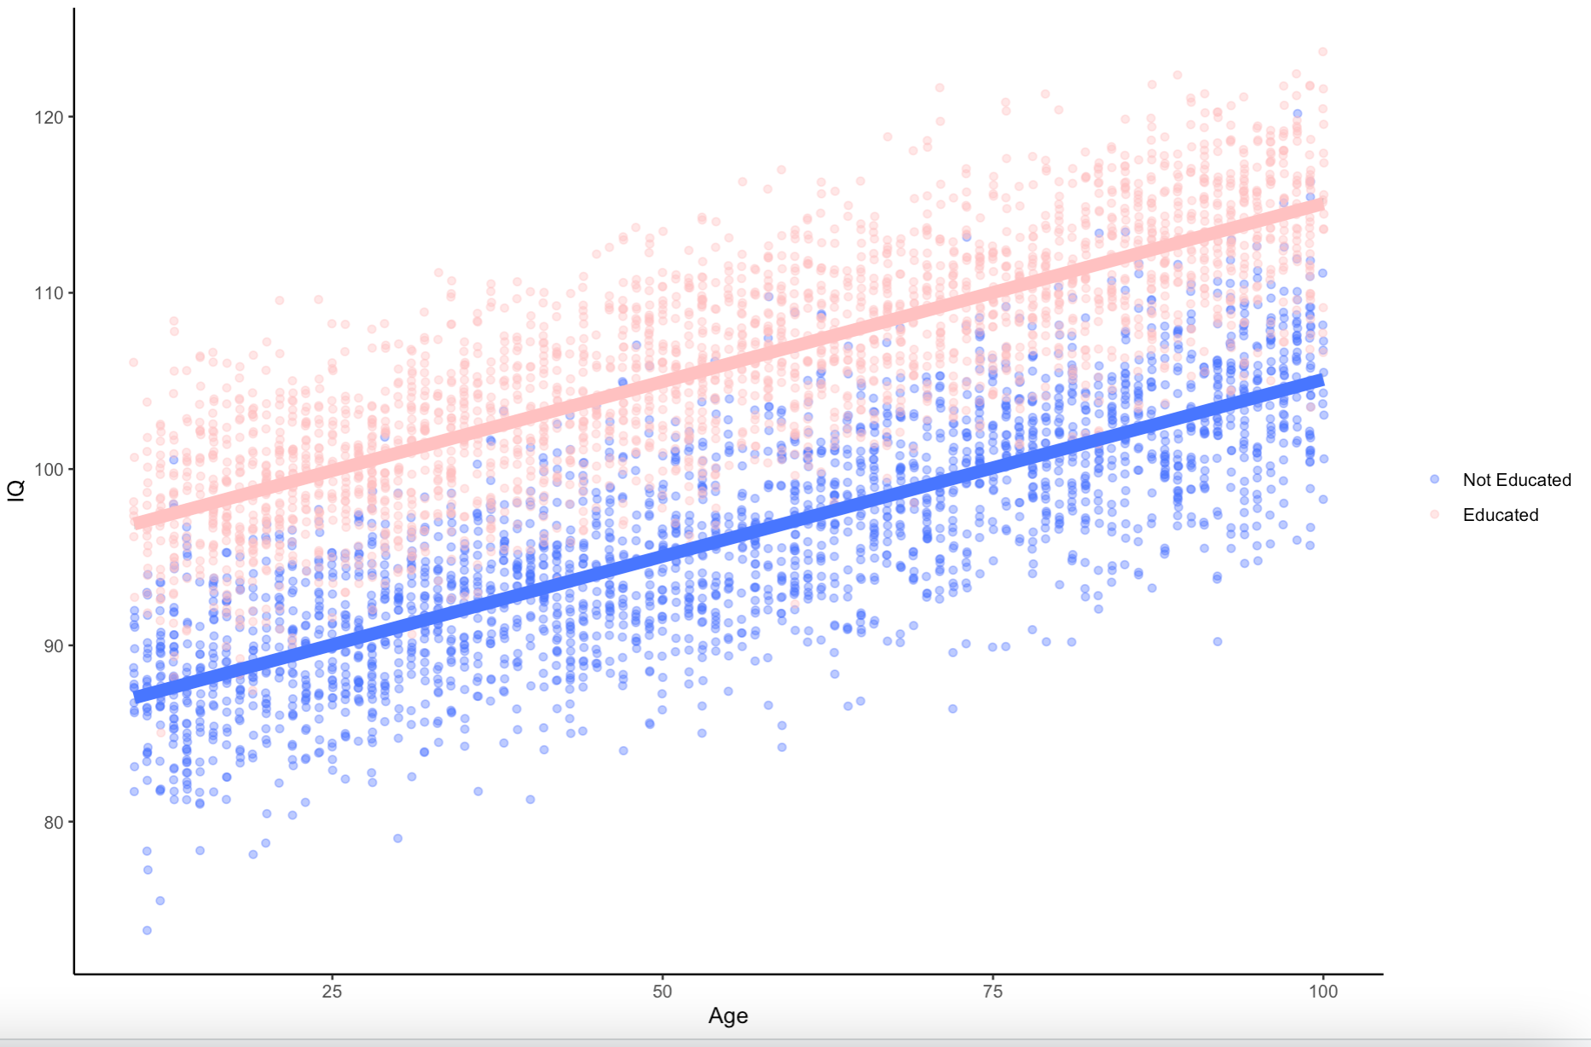
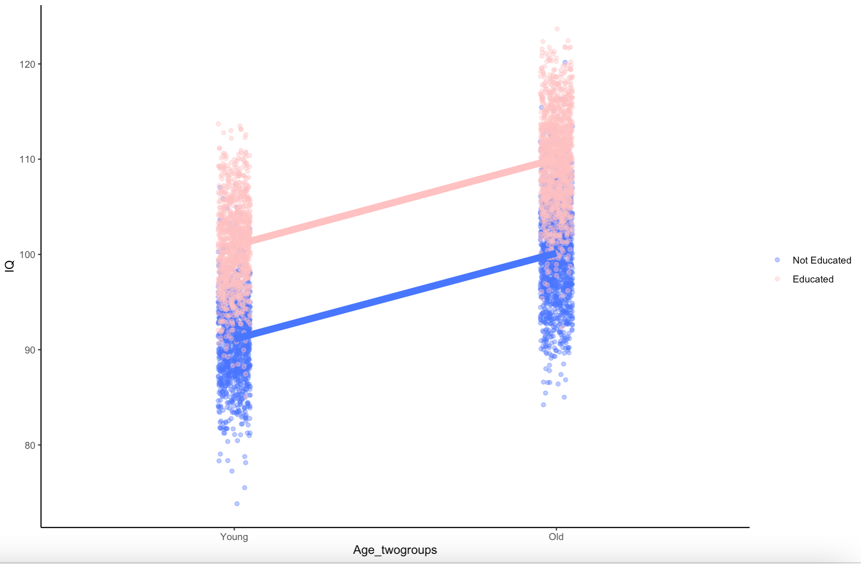
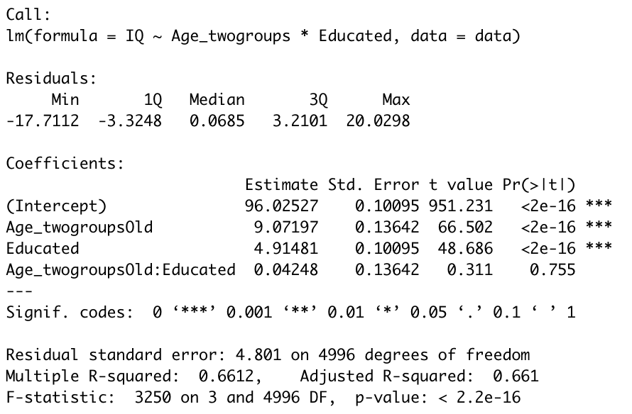
What is this?
Two-Way ANOVA
Equation:
Y ~ β₀ + β₁X₁ + β₂X₂ + ε
IQ ~ β₀ + β₁Age + β₂Education + ε

Slide 17
Equations
DV
Slope
Error
Y ~ β₀ + β₁X₁ + ε
Y-Int
IV

Slide 18
Equations
DV
Slope1
Slope2
Slope3
Error
Y ~ β₀ + β₁X₁ + β₂X₂ + β₃X₃ + ε
Y-Int
IV1
IV2
IV3

Slide 19
Equations
Y ~ β₀ + β₁X₁ + β₂X₂ + β₃X₃ + ε
IQ ~ β₀ + β₁Age + β₂Edu + β₃SES + ε

Slide 20
What is this?
Two-Way ANOVA
Equation:
Y ~ β₀ + β₁X₁ + β₂X₂ + ε
IQ ~ β₀ + β₁Age + β₂Education + ε

Slide 21
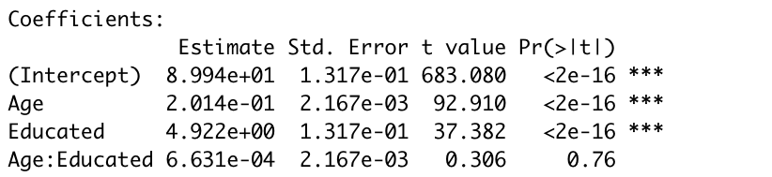
What is this?
Multiple Regression
Equation:
Y ~ β₀ + β₁X₁ + β₂X₂ + ε
IQ ~ β₀ + β₁Age + β₂Education + ε

Slide 22
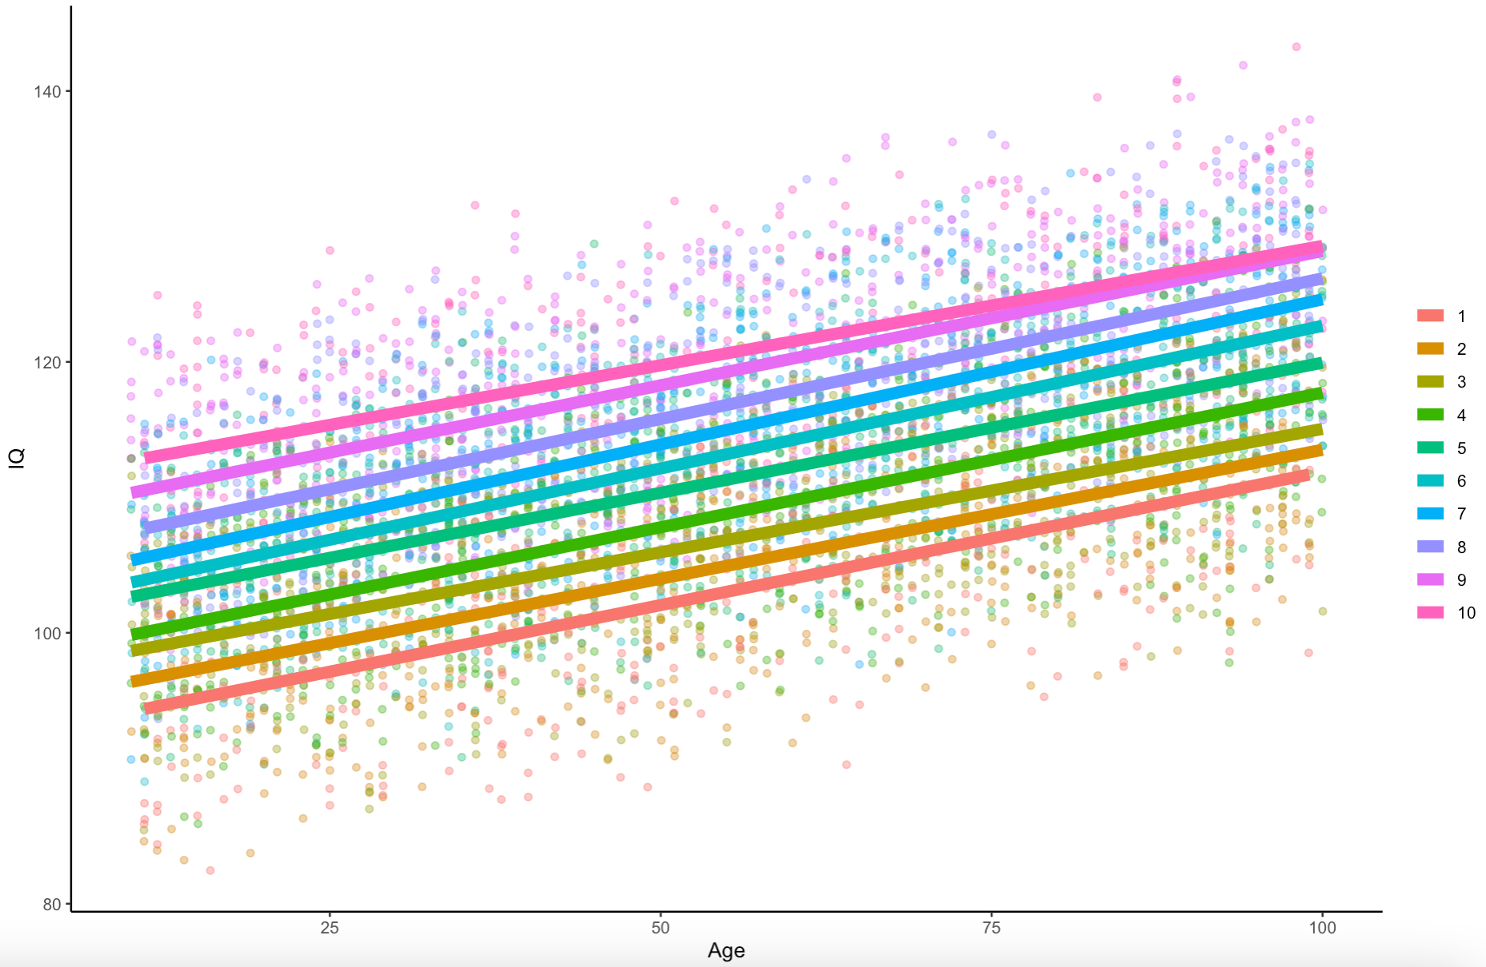
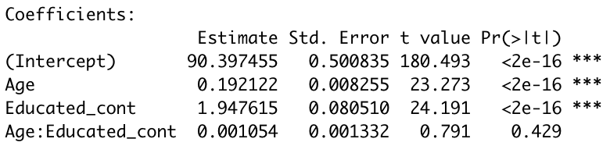
What is this?
Multiple Regression
Equation:
Y ~ β₀ + β₁X₁ + β₂X₂ + ε
IQ ~ β₀ + β₁Age + β₂Education + ε

Slide 23
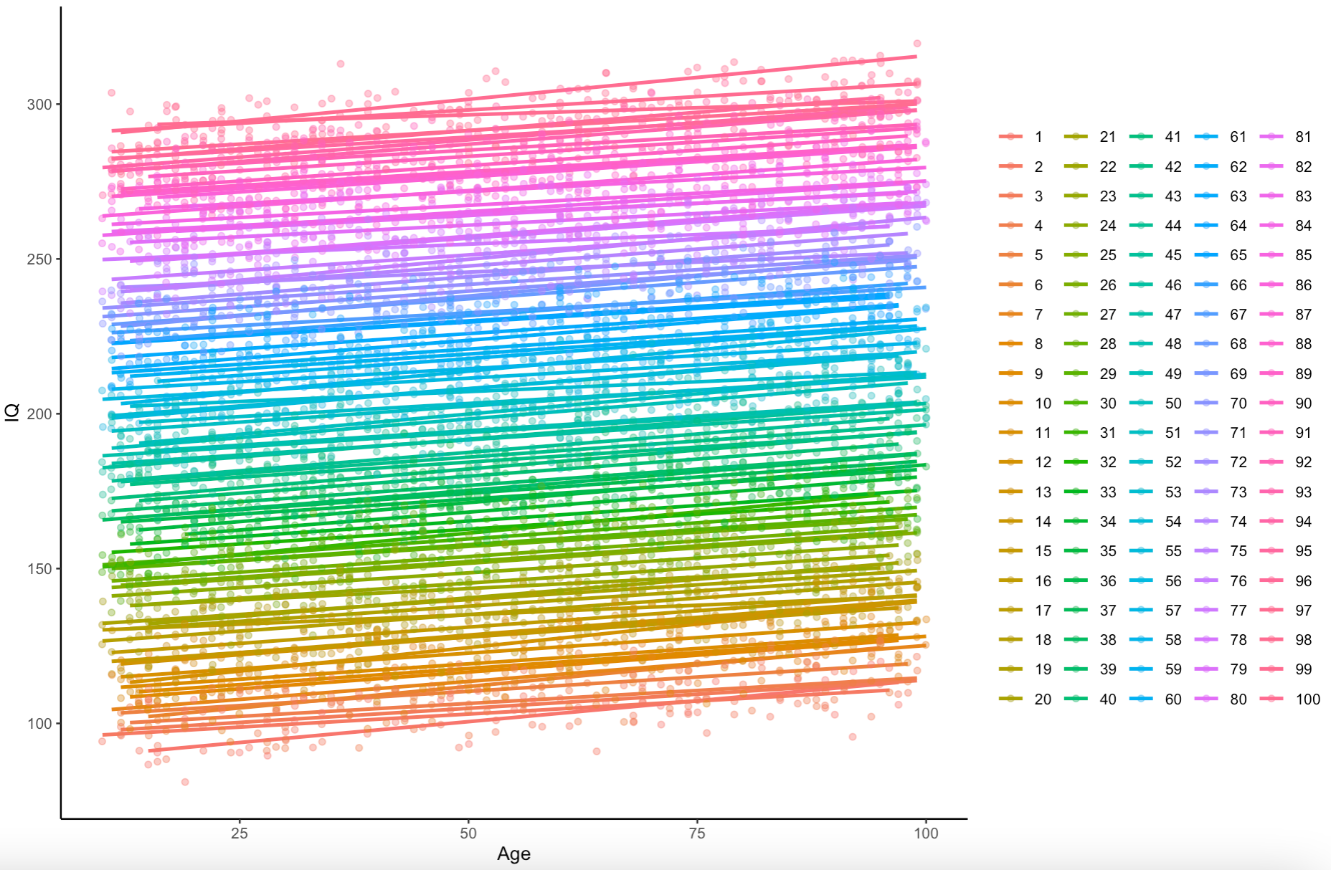
What is this?
Multiple Regression
Equation:
Y ~ β₀ + β₁X₁ + β₂X₂ + ε
IQ ~ β₀ + β₁Age + β₂Education + ε

Slide 24
Coding Variables & Reading Coefficients

Slide 25
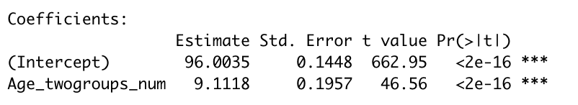
0
1
Dummy Coding:
What is this?
T-Test
Equation:
Y ~ β₀ + β₁X + ε

Slide 26
-1
0
+1
Contrast Coding:
What is this?
T-Test
Equation:
Y ~ β₀ + β₁X + ε

Slide 27
-1
0
+1
Contrast Coding:
What is this?
One-Way ANOVA
Equation:
Y ~ β₀ + β₁X + ε

Slide 28
-1
-1
+2
Contrast Coding:
What is this?
One-Way ANOVA
Equation:
Y ~ β₀ + β₁X + ε

Slide 29
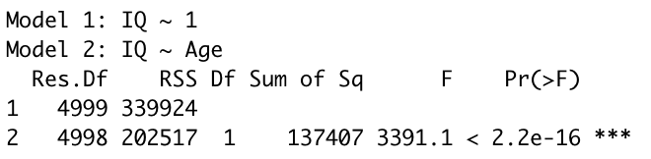
Hierarchical Regression
IQ ~ β₀ + ε
IQ ~ β₀ + β₁Age + ε

Slide 30
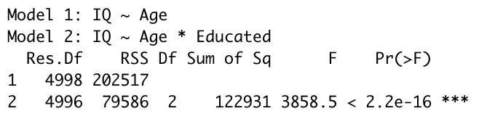
Hierarchical Regression
IQ ~ β₀ + β₁Age + ε
IQ ~ β₀ + β₁Age + β₂Education + ε

Slide 31
Outline
Multiple Regression Conceptual
Multiple Regression Applied
Moderation Conceptual
Mediation Conceptual
Moderation Applied
Mediation Applied

Slide 32

Multiple Regression in R

Slide 33
Outline
Multiple Regression Conceptual
Multiple Regression Applied
Moderation Conceptual
Mediation Conceptual
Moderation Applied
Mediation Applied

Slide 34

DISCLAIMER

Slide 35
Moderation
M
IV
DV

Slide 36
Moderation
Self-Efficacy
Task Importance
Task Anxiety

Slide 37
Moderation
M
IV
DV

Slide 38
Outline
Multiple Regression Conceptual
Multiple Regression Applied
Moderation Conceptual
Mediation Conceptual
Moderation Applied
Mediation Applied

Slide 39
Mediation
IV
M
DV

Slide 40
Mediation
M
IV
DV

Slide 41
Mediation
Access to Healthcare
Income
Years lived

Slide 42
Mediation (Path Analysis – Baron & Kelly, 1986)
IV
DV
C
M
A
B
IV
DV
C’

Slide 43
Mediation (Path Analysis – Baron & Kelly, 1986)
IV
DV
C
M
A
B
IV
DV
C’

Slide 44
Outline
Multiple Regression Conceptual
Multiple Regression Applied
Moderation Conceptual
Mediation Conceptual
Moderation Applied
Mediation Applied

Slide 45
Moderation and Mediation in R

